Slide 1
CS4038
DATA MINING
LECTURE # 11
SPRING 2024
FAST – NUCES, CFD CAMPUS
AYESHA LIAQAT
ayesha.liaqat@nu.edu.pk

Slide 2
TODAY’S TOPICS
Rule-based classifier (cont’d)
Learning rules: direct and indirect methods

Slide 3
BUILDING CLASSIFICATION RULES

Slide 4
BUILDING CLASSIFICATION RULES
Direct Method:
Extract rules directly from data
Examples: RIPPER, CN2, Holte’s 1R
Indirect Method:
Extract rules from other classification models (e.g., decision trees, neural networks, etc.).
Examples: C4.5rules

Slide 5
SEQUENTIAL COVERING METHOD
RULE INDUCTION: DIRECT METHOD

Slide 6
RULE INDUCTION: SEQUENTIAL COVERING METHOD
Sequential covering algorithm: Extracts rules directly from training data
Typical sequential covering algorithms: FOIL, AQ, CN2, RIPPER
Rules are learned sequentially, each for a given class C_{i} will cover many tuples of C_{i} but none (or few) of the tuples of other classes
Steps:
Rules are learned one at a time
Each time a rule is learned, the tuples covered by the rules are removed
Repeat the process on the remaining tuples until termination condition, e.g., when no more training examples or when the quality of a rule returned is below a user-specified threshold

Slide 7
EXAMPLE OF SEQUENTIAL COVERING
Rule Induction Steps:
Rules are learned one at a time
Each time a rule is learned, the tuples covered by the rules are removed
Repeat the process on the remaining tuples until termination condition, e.g., when no more training examples or when the quality of a rule returned is below a user-specified threshold
R1
R1
R2
(i) Original Data
(ii) Step 1
(iii) Step 2
(iv) Step 3

Slide 8
1. Start from an empty rule
DIRECT METHOD: SEQUENTIAL COVERING
Grow a rule using the Learn-One-Rule function
Used to extract the best rule for class y that many of the positive examples and none (or very few) of the negative examples in the training set.
Remove training records covered by the rule
Repeat Step (2) and (3) until stopping criterion is met
Repeat the process on the remaining tuples until termination condition, e.g., when no more training examples or when the quality of a rule returned is below a user-specified threshold

Slide 9
HOW TO LEARN-ONE-RULE?
Start with the most general rule possible
condition = empty (r : { } → y})
Adding new attributes by adopting a greedy depth-first strategy
Picks the one that most improves the rule quality
favors rules that have high accuracy and cover many positive tuples

Slide 10
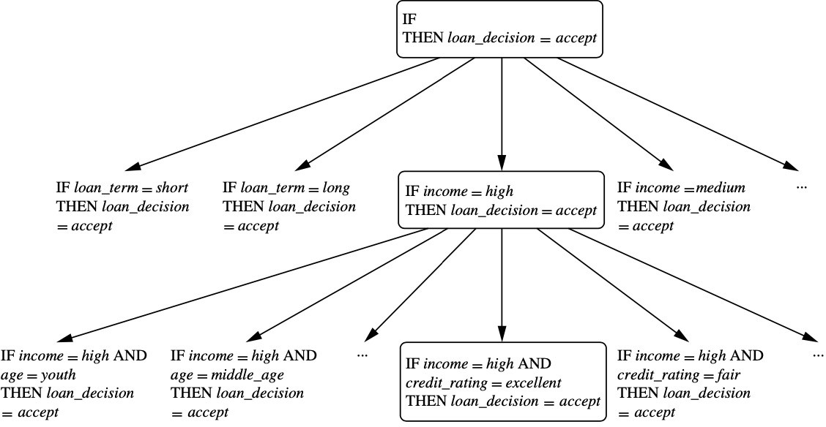
DIRECT METHOD: SEQUENTIAL COVERING

Slide 11
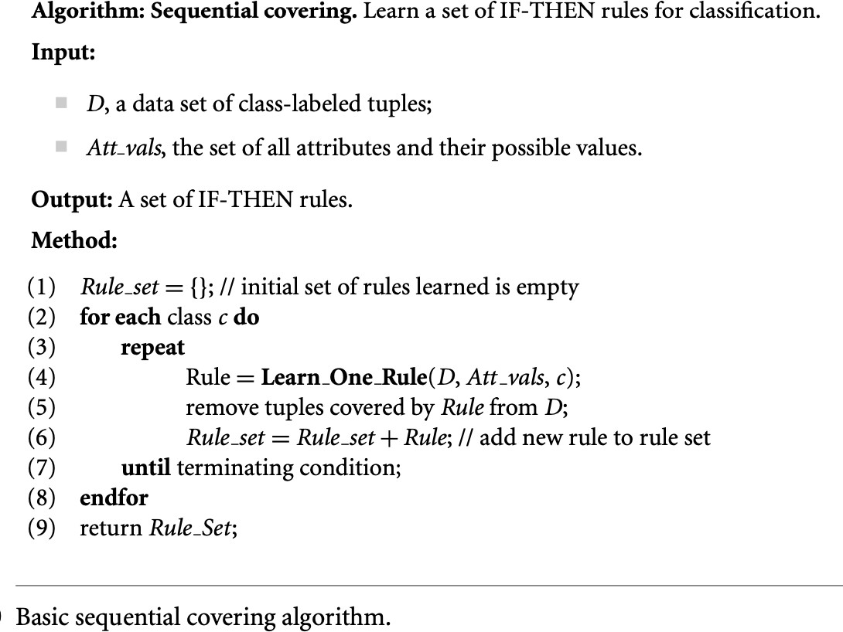
DIRECT METHOD: SEQUENTIAL COVERING

Slide 12
ASPECTS OF SEQUENTIAL COVERING
Rule growing
Rule evaluation
Instance elimination
Stopping criterion
Rule pruning

Slide 13
Two common strategies
RULE GROWING
{ }
Yes: 3
No: 4
Refund=No, Status=Single, Income=85K (Class=Yes)
Refund=No, Status=Single, Income=90K (Class=Yes)
...
Refund= No
Status = Single
Status = Divorced
Status = Married
Income
> 80K
Refund=No, Status = Single (Class = Yes)
Yes: 3
No: 4
Yes: 2
No: 1
Yes: 1
No: 0
Yes: 0
No: 3
Yes: 3
No: 1
(a) General-to-specific
(b) Specific-to-general
Begin with r : { } → y
The rule has poor quality because it covers all the examples in the training set.
One of the positive examples is randomly chosen as the initial seed for the rule- growing process.
The rule is generalized by removing one o13f its conjuncts so that it can cover more positive examples

Slide 14
RULE EVALUATION
An evaluation metric is needed to determine which conjunct should be added (or removed) during the rule-growing process.
Accuracy: measures the fraction of training examples classified correctly by the rule.
Limitation: it does not take into account the rule’s coverage.

Slide 15
RULE QUALITY MEASURES COMPARISON
Consider a training data set that contains 60 positive examples and 100 negative examples.
Let’s suppose we have got two rules.
Rule r₁: covers 50 positive examples and 5 negative examples, Rule r₂: covers 2 positive examples and no negative examples.
What will be the accuracy of both rules?
Accuracy(r₁) = 50/55 = 90.9% Accuracy(r₂) = 2/2 = 100%
Is r₂ really a good rule, as suggested by the accuracy measure?
Solution: use an evaluation metric that relies on both accuracy and coverage of a rule

Slide 16
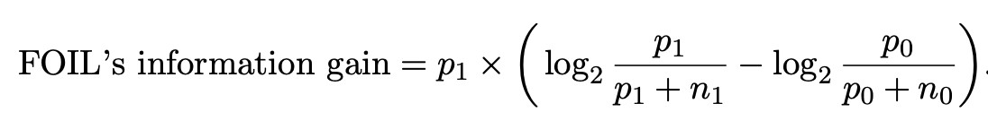
FOIL’S INFORMATION GAIN
An evaluation metric that takes into account the support count of the rule.
Support count of a rule equals the number of positive examples covered by the rule.
Example:
r:
r₁:
A → +
(A and B) → +
covers p₀ positive and n₀ negative examples covers p₁ positive and n₁ negative examples
FOIL’s information gain of the extended rule (r₁) is:

Slide 17
RULE QUALITY MEASURES COMPARISON
Consider a training data set that contains 60 positive examples and 100 negative examples.
Let’s suppose we have got two rules.
Rule r₁: covers 50 positive examples and 5 negative examples, Rule r₂: covers 2 positive examples and no negative examples.
What will be the accuracy of both rules?
Accuracy(r₁) = 50/55 = 90.9% Accuracy(r₂) = 2/2 = 100%
What will be the FOIL’s information gain of both rules?
FOIL’s gain (r₁) = 43.12 FOIL’s gain (r₂) = 2
Notes:
P0=60 No=100, P1=50, N1=5 50*(-0.1375+1.4150)=63 0-

Slide 18
RULE GENERATION
To generate a rule
while(true)
find the best predicate p
if foil-gain(p) > threshold then add p to current rule
else break
A3=1&&A1=2
&A&3_{A}=1₈&₌₅&A1=2
A3=1
Positive examples
Negative examples

Slide 19
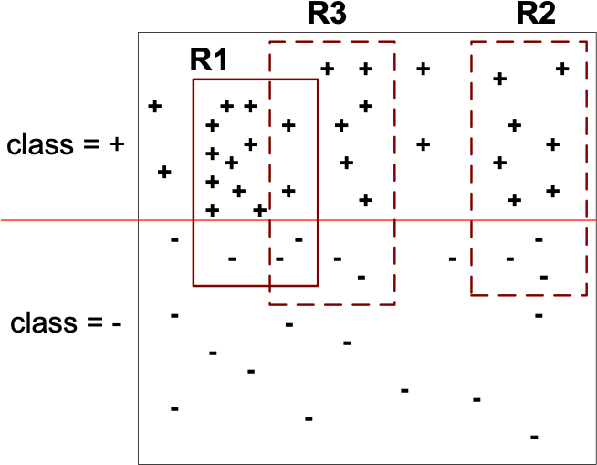
INSTANCE ELIMINATION
Why do we need to eliminate instances?
Otherwise, the next rule is identical to previous rule
Why do we remove positive instances?
Ensure that the next rule is different
Why do we remove negative instances?
Prevent underestimating accuracy of rule
Compare rules R2 and R3 in the diagram
29 positive and 21 negative examples
Notes:
R1=12/15=80 R1+R3= 18/23=78, R1+R2= 19/25= 76 R2=70, R3=6/8=75
R3=8/12=66.7
R2=7/10=70

Slide 20
STOPPING CRITERION AND RULE PRUNING
Stopping criterion
Compute the gain
If gain is not significant, discard the new rule
Rule Pruning
Similar to post-pruning of decision trees – Reduced Error Pruning: remove one of the conjuncts in the rule
Compare error rate on validation set before and after pruning
If error improves, prune the conjunct

Slide 21
SUMMARY OF DIRECT METHOD
Grow a single rule
Remove Instances from rule
Prune the rule (if necessary)
Add rule to Current Rule Set
Repeat …

Slide 22
CHARACTERISTICS OF RULE-BASED CLASSIFIERS
The expressiveness of a rule set is almost equivalent to that of a decision tree.
Rule-based classifiers are generally used to produce descriptive models that are easier to interpret, but gives comparable performance to the decision tree classifier.
The class-based ordering approach adopted by many rule-based classifiers (such as RIPPER) is well suited for handling data sets with imbalanced class distributions.

Slide 23
READING MATERIAL
Chapter 4:Tan, Steinbach & Kumar
Chapter 8: Han, Kamber & Pei

